Slide 1

CAMPUS KART RACING GAME
Project Members:
Ozan Çetiner - 201511012
Esra Şahin - 201511055
Buğra Doğan - 201711205
Nurettin Cem Altunbulduk - 201411004
Advisor: Murat Saran

Slide 2
Contents
Project Information
Development Tools
Graphic Design
Challenges
Solution
Artificial Intelligence
Project Plan
Demo

Slide 3
Project Information
Cross-Platform (Windows - Android)
Singleplayer
Multiplayer
Campus Map
Kart Customization

Slide 4



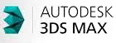
Development Tools

Slide 5
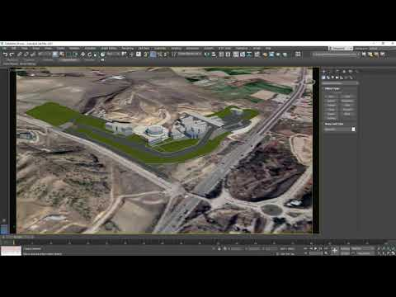
Graphic Design
3D View of Campus

Slide 6
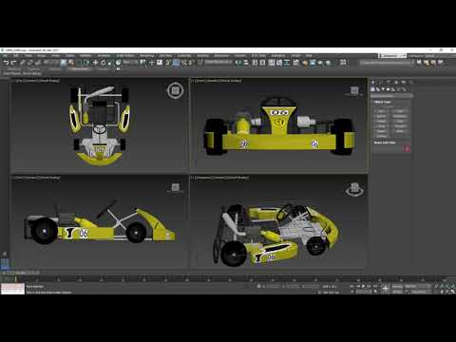
Graphic Design
3D Karts

Slide 7
Challenges
FPS - Frame Per Second (Higher is better.)

Slide 8
Challenges
PING (Lower is better.)

Slide 9
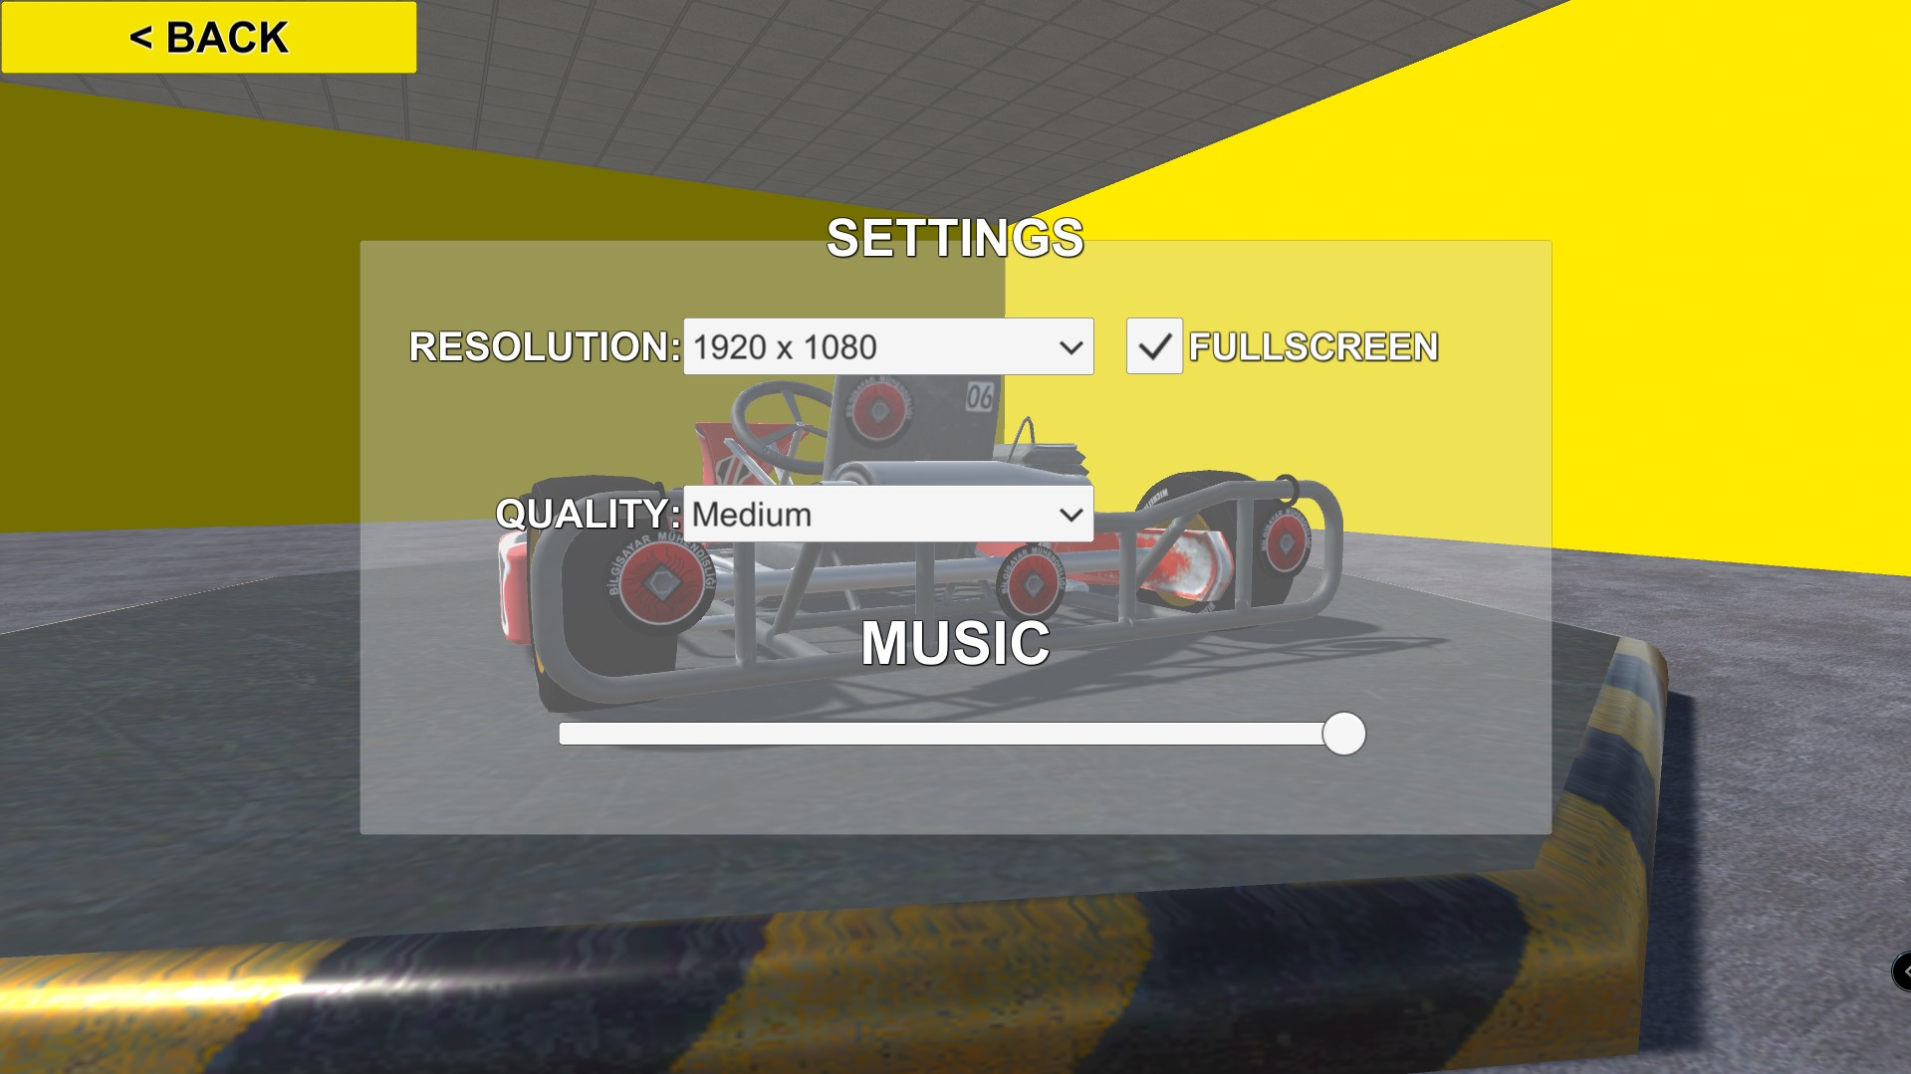
Solution
FPS
Resolution and Quality Settings

Slide 10
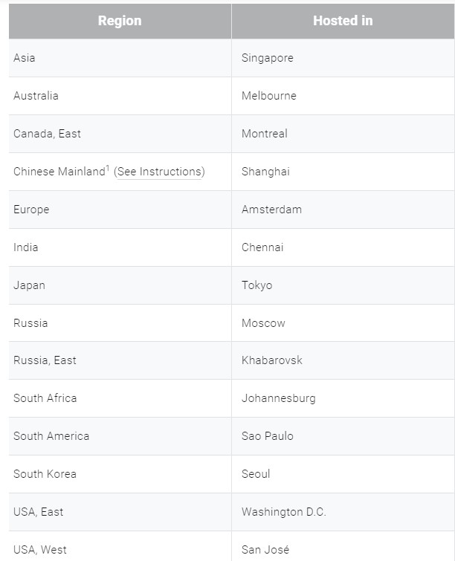
Solution
PING
Different servers offered by Photon.

Slide 11
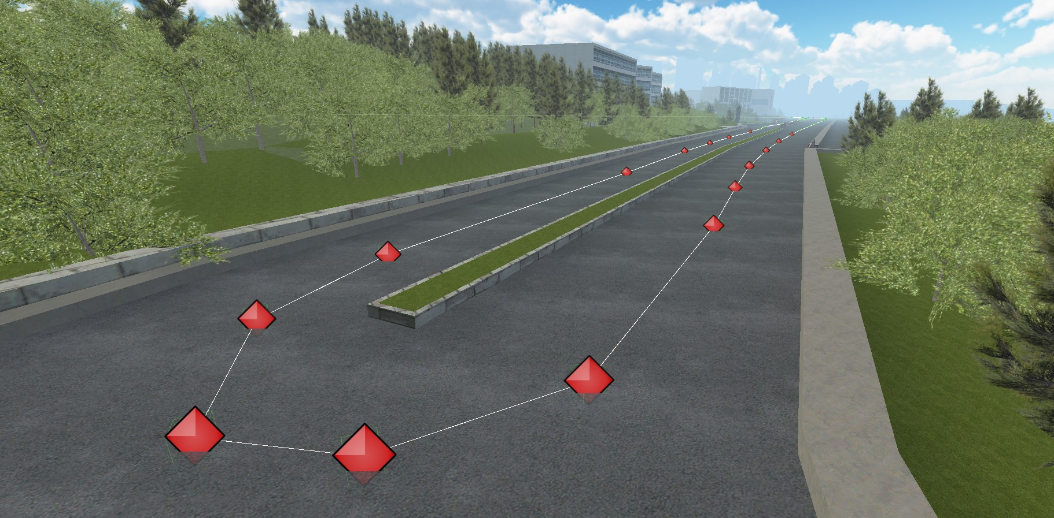
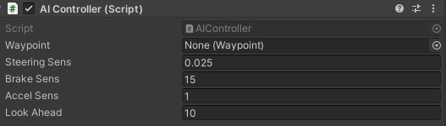
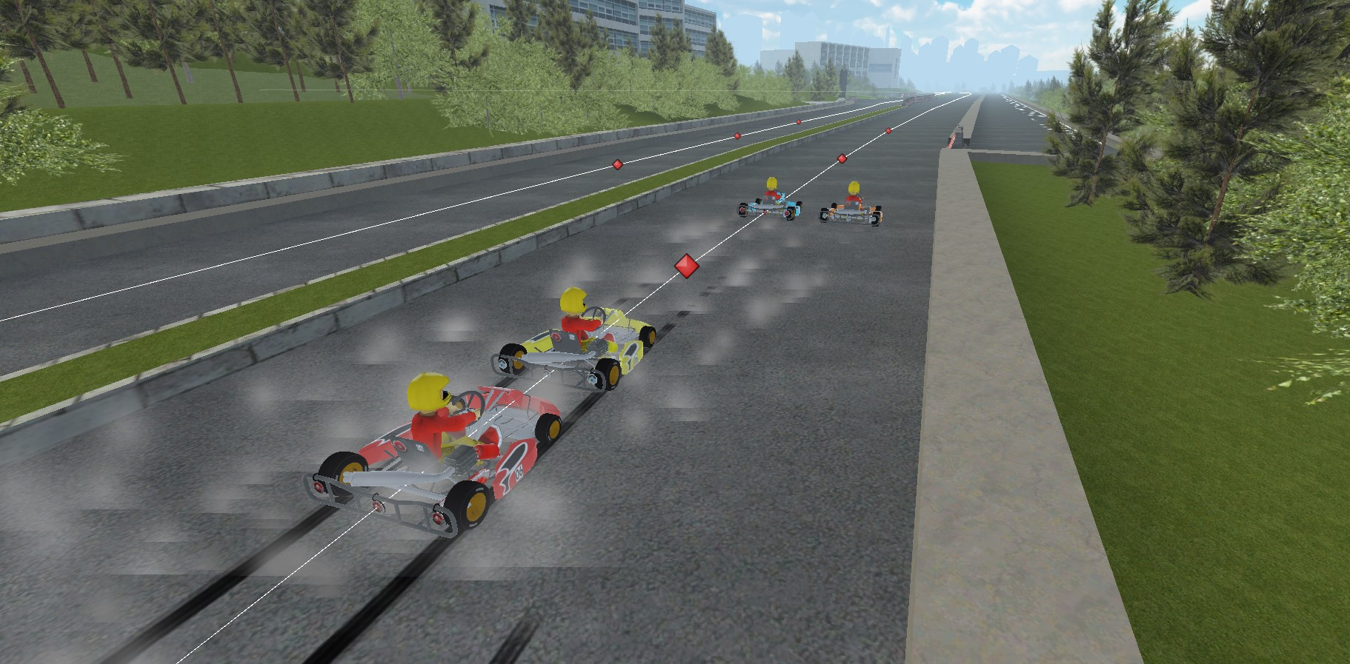
Artificial Intelligence -
PATH FOLLOW

Slide 12
Project Plan / Team Member Responsibilities
Ozan Çetiner
Game Animations,Menu Design
Esra Şahin
Game Music,Lighting
Buğra Doğan
Game Logic,AI,Lighting,Menu Design
Nurettin Cem Altunbulduk
Game Logic,AI
Team
3D Modelling,Sound Effect

Slide 13
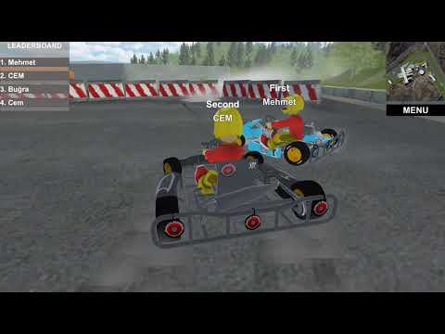
Demo

Slide 14
THANK YOU!

